Slide 1
HAOYI SONG
songhaoyi969@gmail.com

Slide 2
Overview
Personal Artwork
Community Art Programs
Events and Exhibition

Slide 3
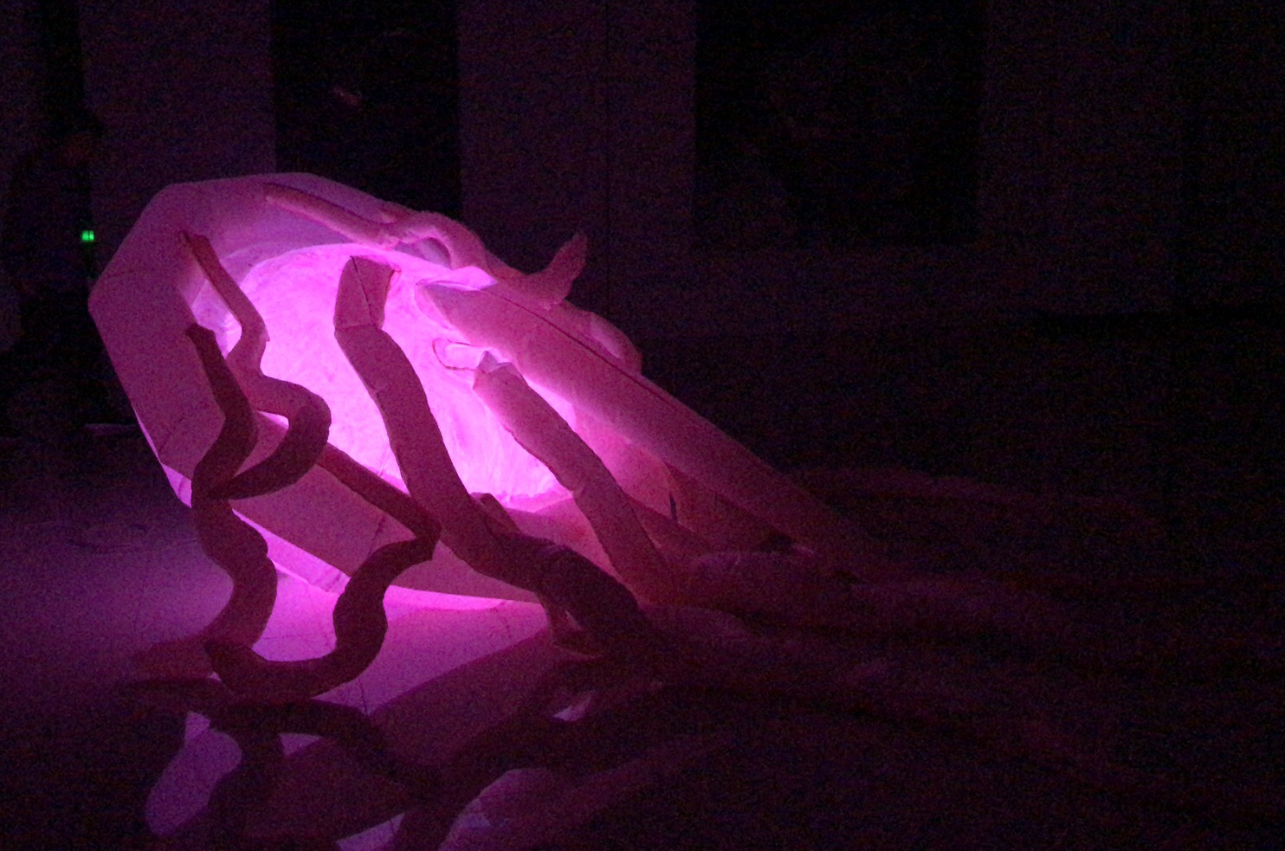
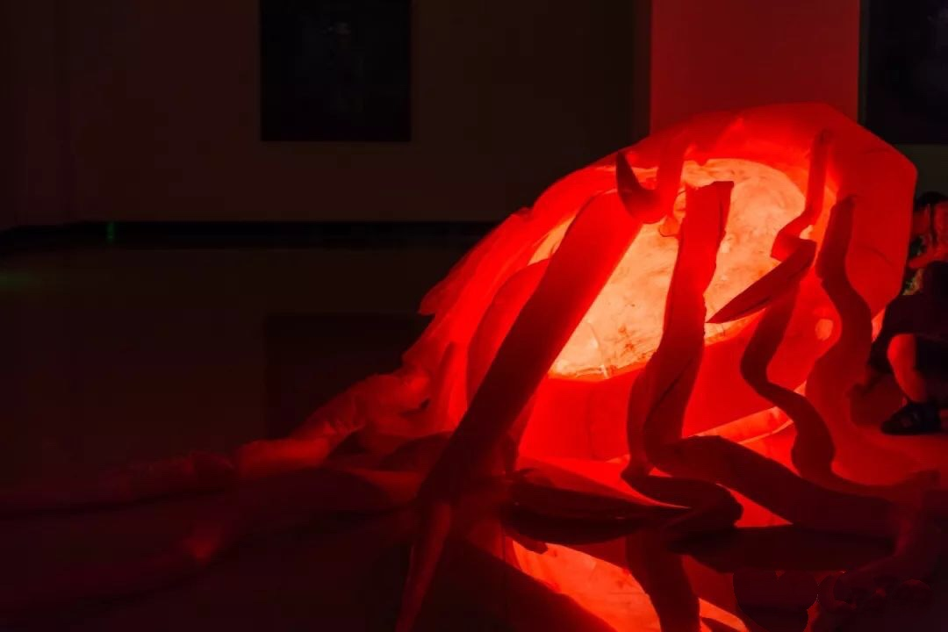
Probes (2018)
Inflatable, light-infused installation
141 x 78 x 55 inches
Acrylic, plastic, led lights, sound speakers
This installation was set in a dark room to integrate the beauty of movement with rhythmic music change.
This project aimed to present the interaction between society and women, especially how women respond to societal pressures. Gentle, shifting color probes represent the soft but determined female spirit.

Slide 4
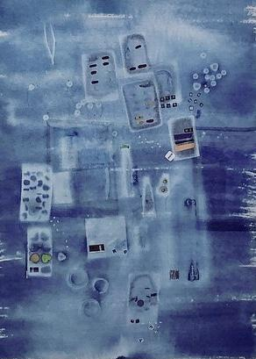
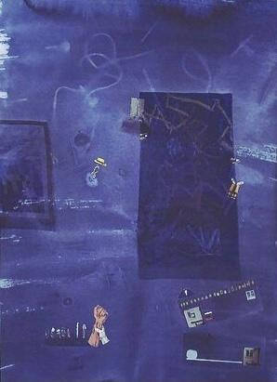
Exposure (2019)
Collage
22 x 30 inches
paper, cyanotype emulsion, sunlight, magazines, capsule blisters, wires, and nails.
This series of collage work incorporated the cyanotype technique and mixed materials from daily life.
This project expressed the struggles of people exposed to materialism and commercialism.

Slide 5
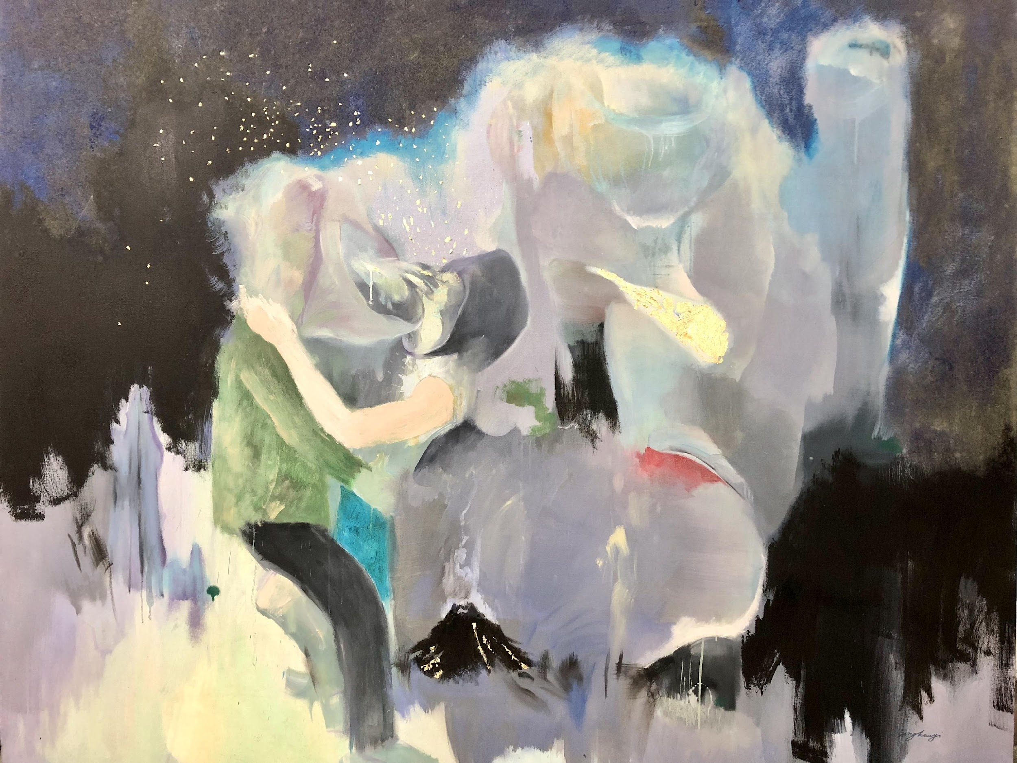
Rose-Colored Filter (2016)
Oil on Canvas
98 x 118 inches
Oil paint, linen canvas, genuine gold leaf sheets.
This painting is designed to convey the rose-colored fantasy and memory of a woman in a heterosexual relationship. The woman is immersed in the social power and moral authority of a patriarchal society, but is blind with the rose-colored filter.

Slide 6
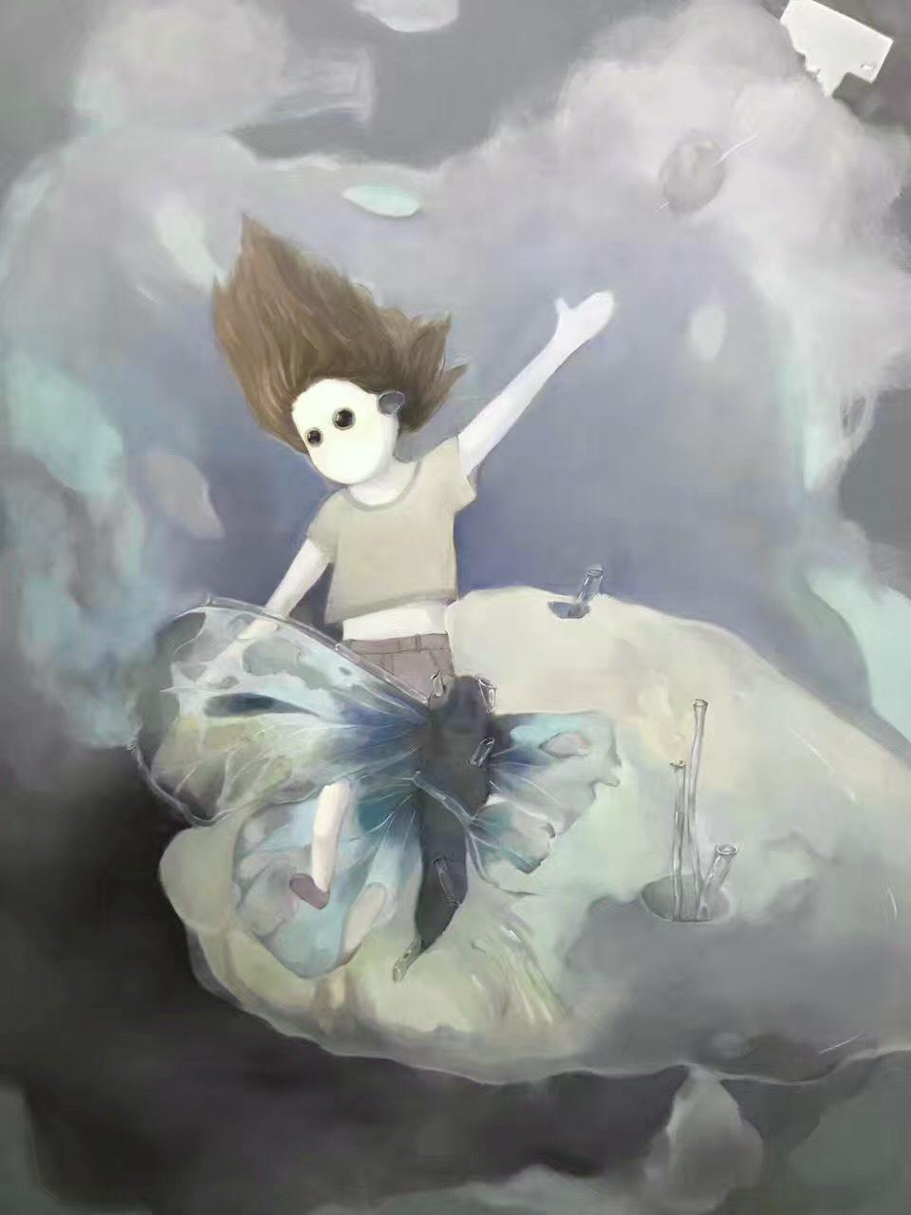
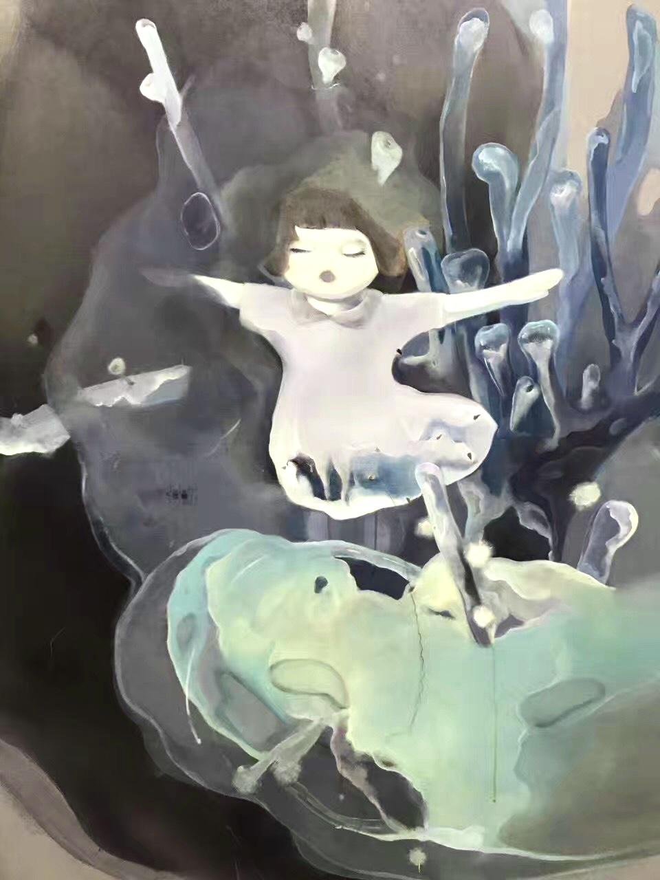
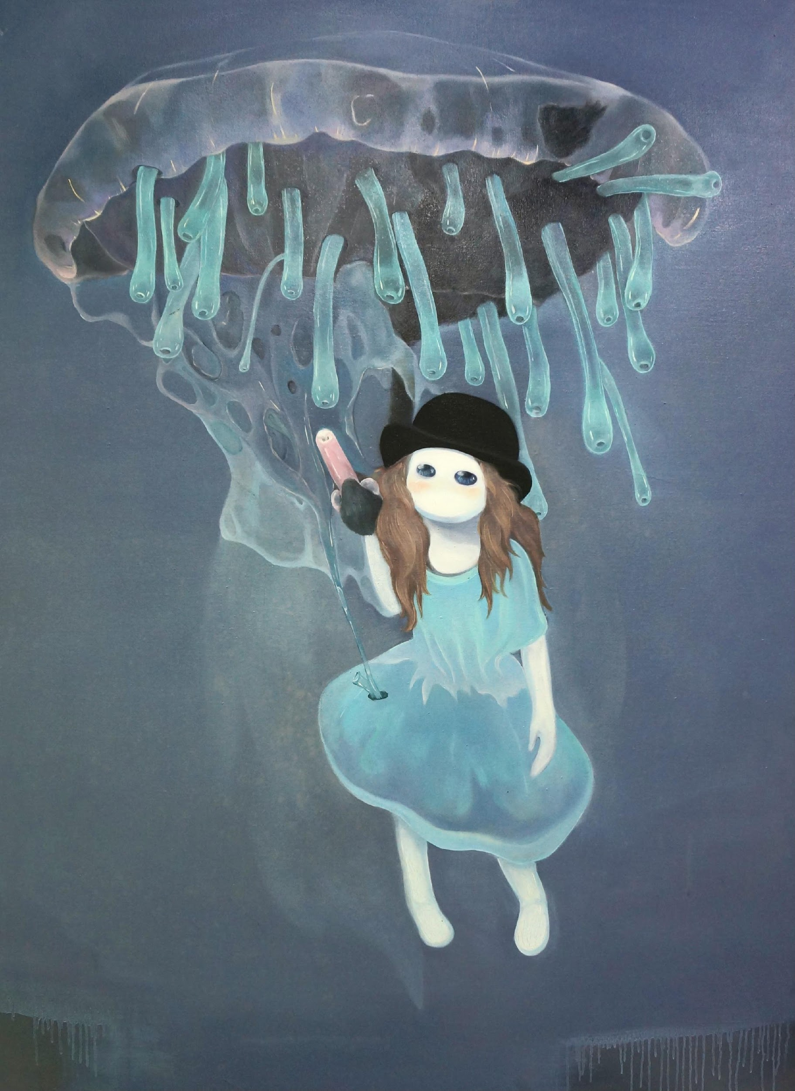
Floating Dreams (2009)
Oil on Canvas
48 x 60 inches
Oil paint, linen canvas.
This series of work illustrated my childhood memories. The freedom of exploration and joy in adventure disappeared in adulthood but flash back in fantasy and dreams.

Slide 7
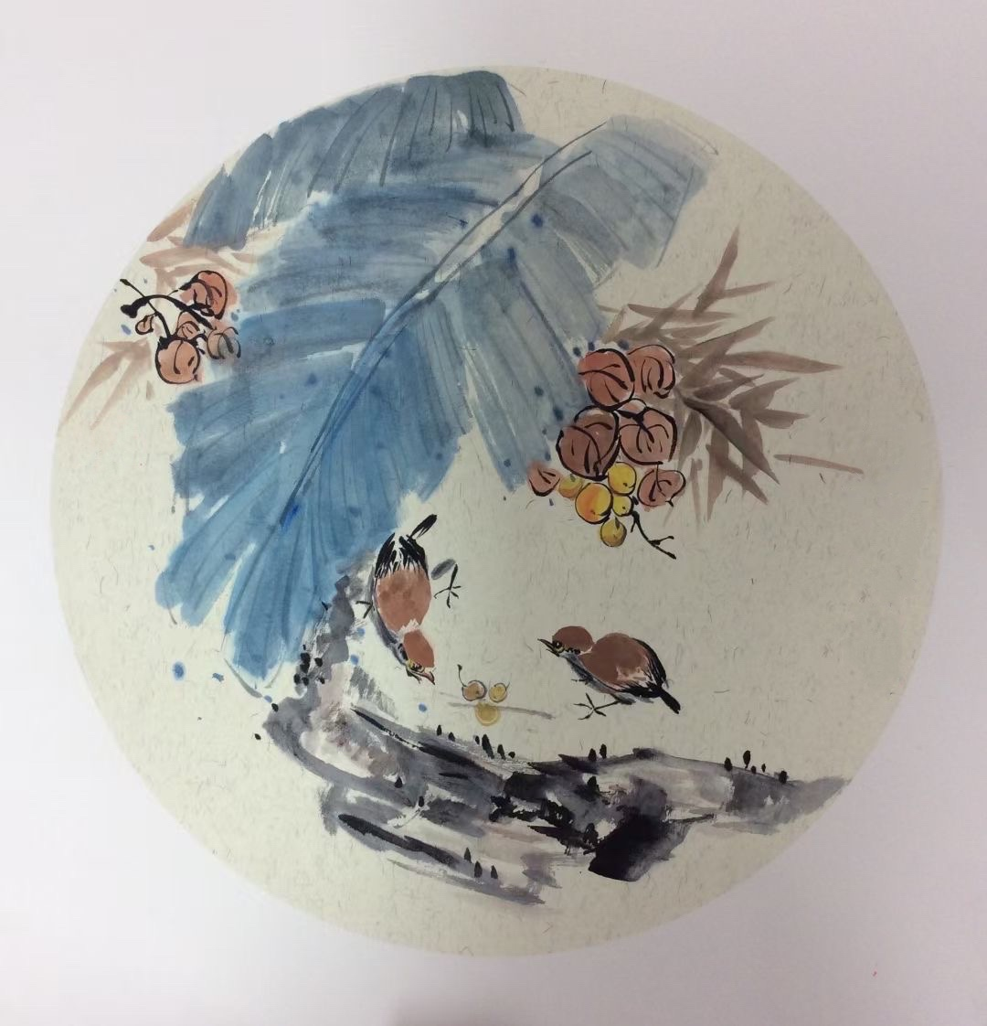
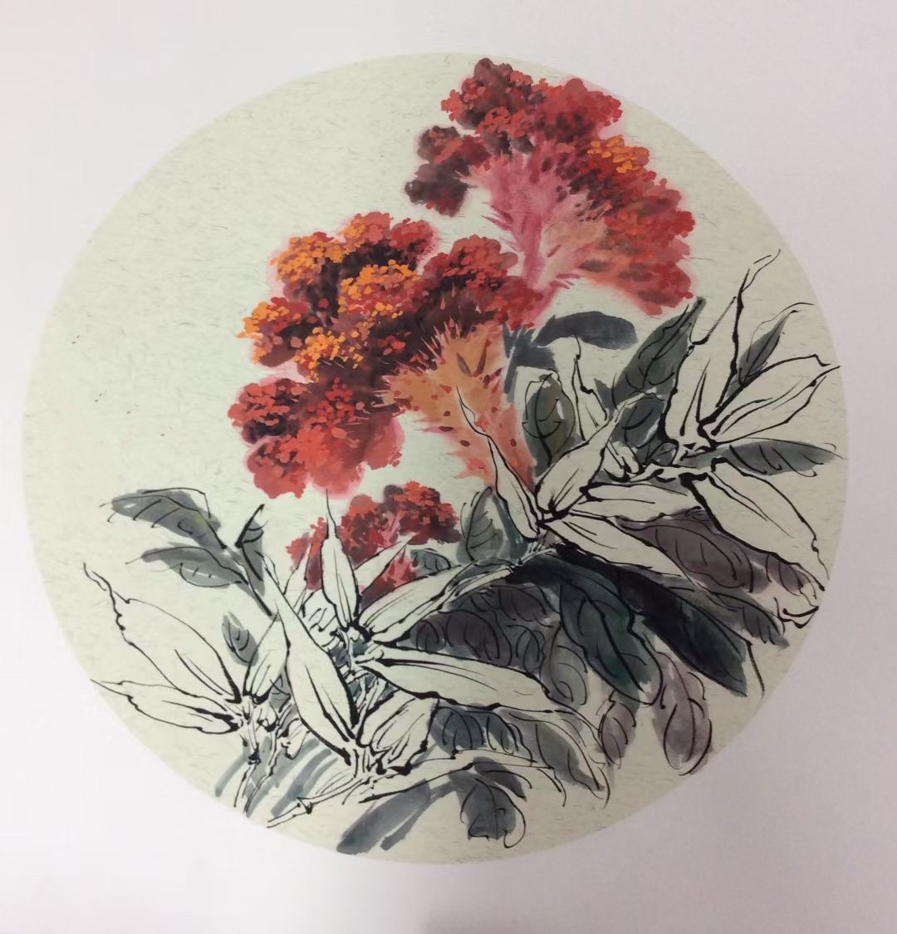
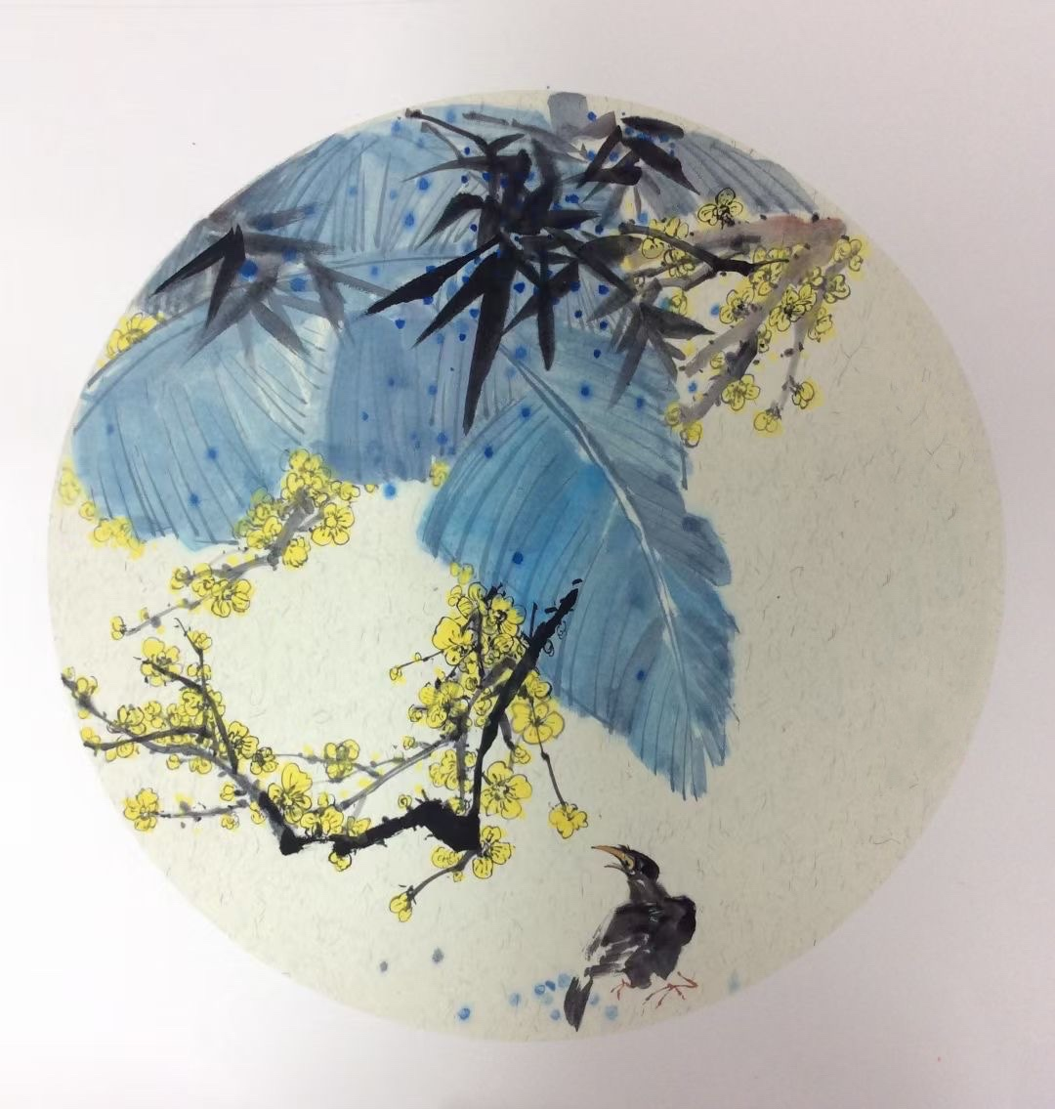

Slide 8
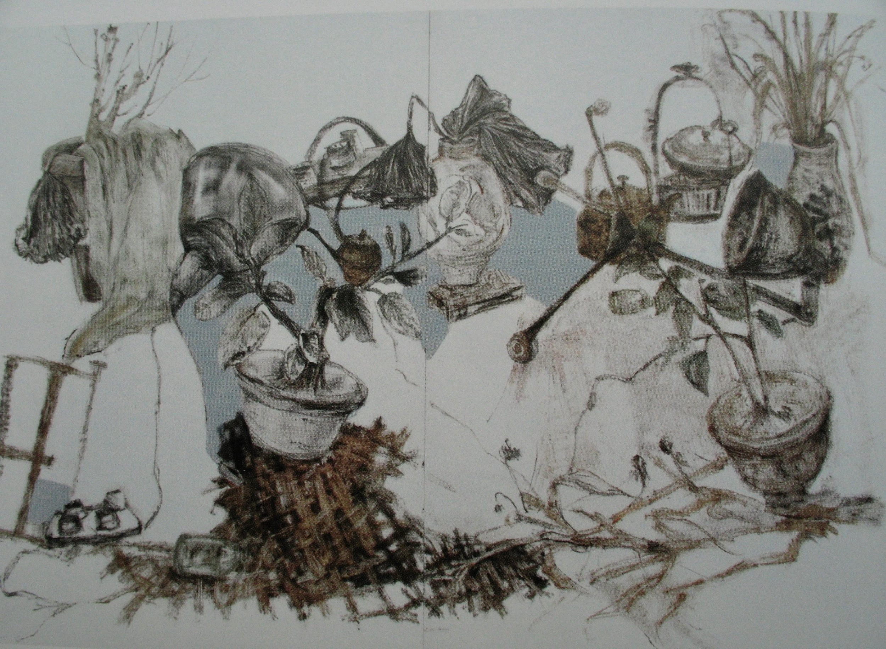
Homeland I (2008)
Oil on Paper
48 x 62 inches
Oil paint, papers
This observational painting was created in the fall season. The objects were representative of the decay present in the natural world, such as dead leaves and discarded implements.
The art conveys the vanishing of one’s homeland and traditional life in childhood due to the rapid development of the economy and modern technology.

Slide 9
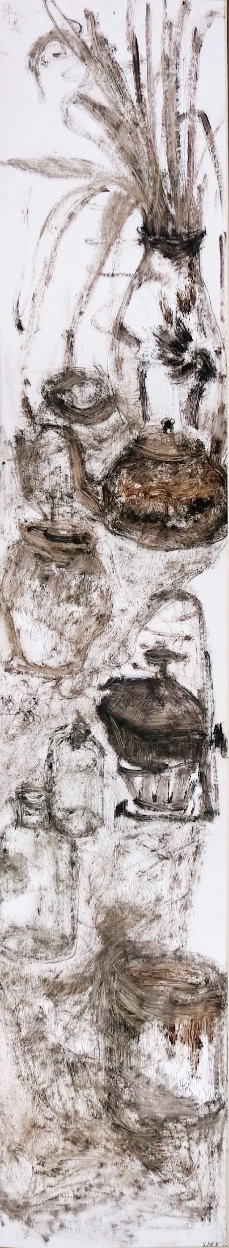
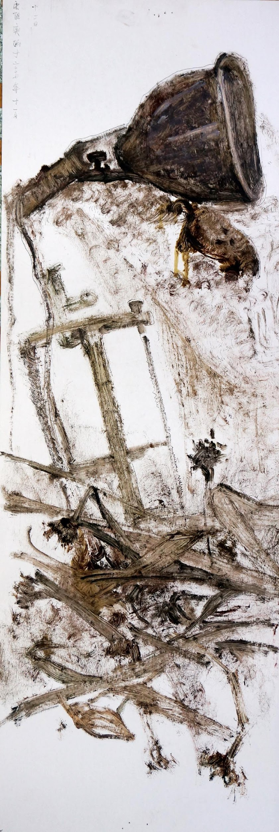
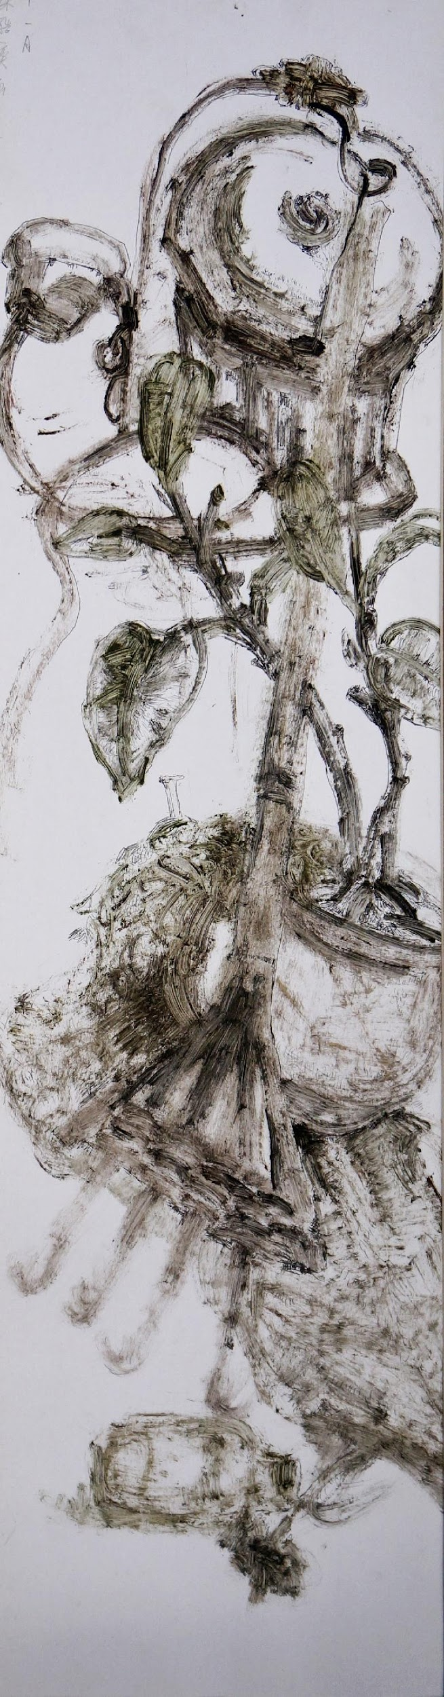
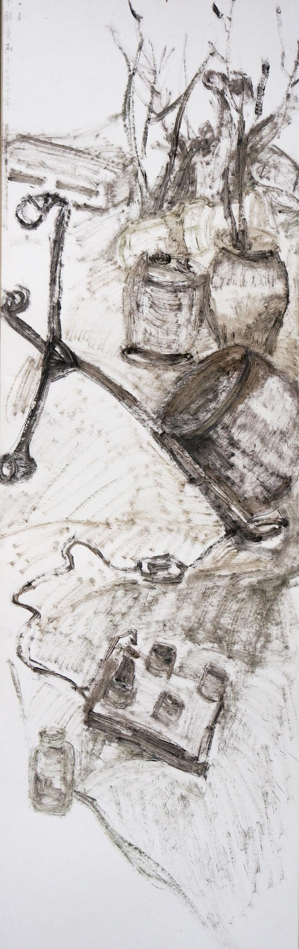
Homeland II, III, IV, V (2008)
Oil on Paper
8, 16, 12, 16 x 62 inches
Oil paint, papers
This series used a typical structure and pattern found in traditional Chinese painting.
It expresses sadness towards the decay of traditional culture.

Slide 10
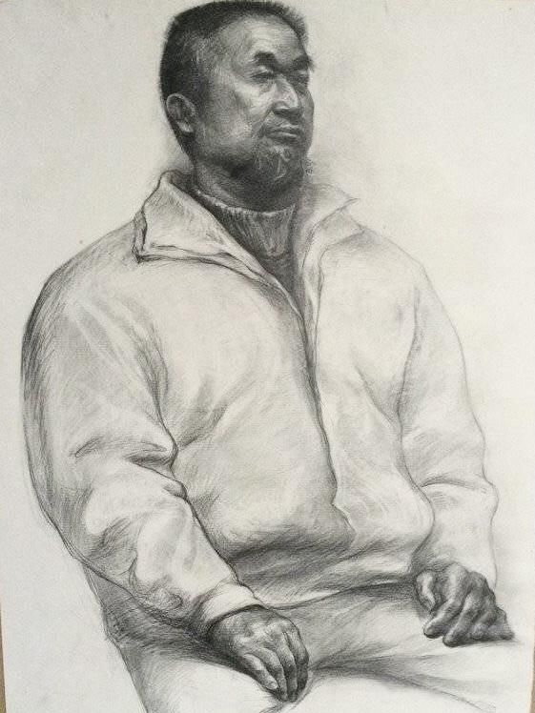
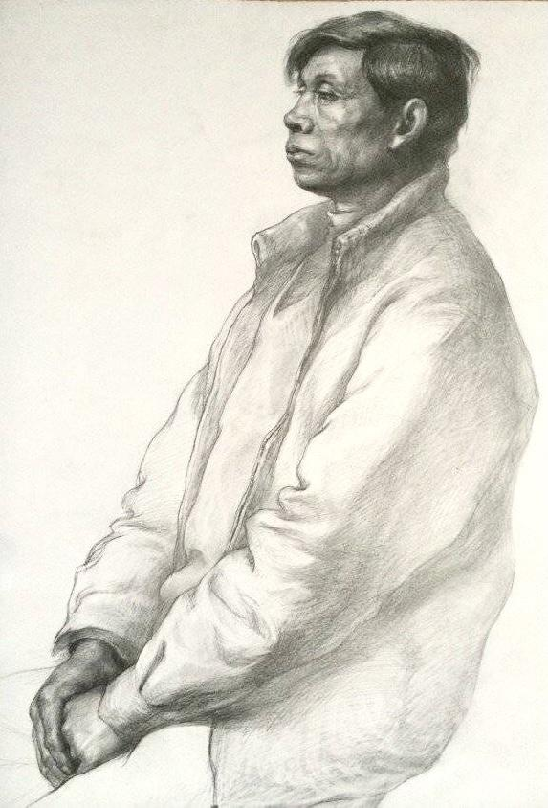
Porter I, II (2011)
Portrait
22 x 30 inches
Pencil, papers
This series was composed of observational sketches for porters, who represent the laboring class in Chongqing, a city located in the southwest China.

Slide 11
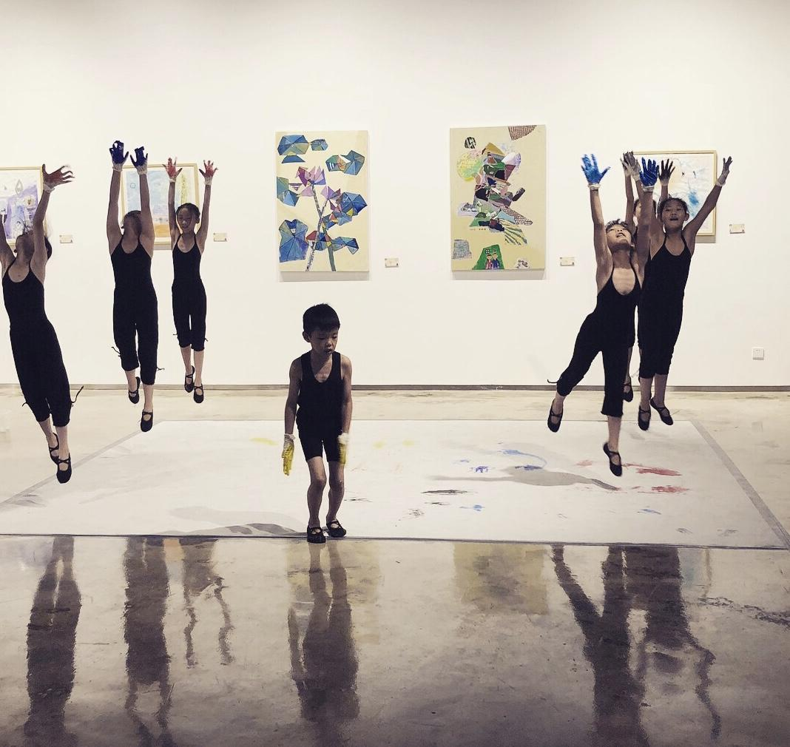
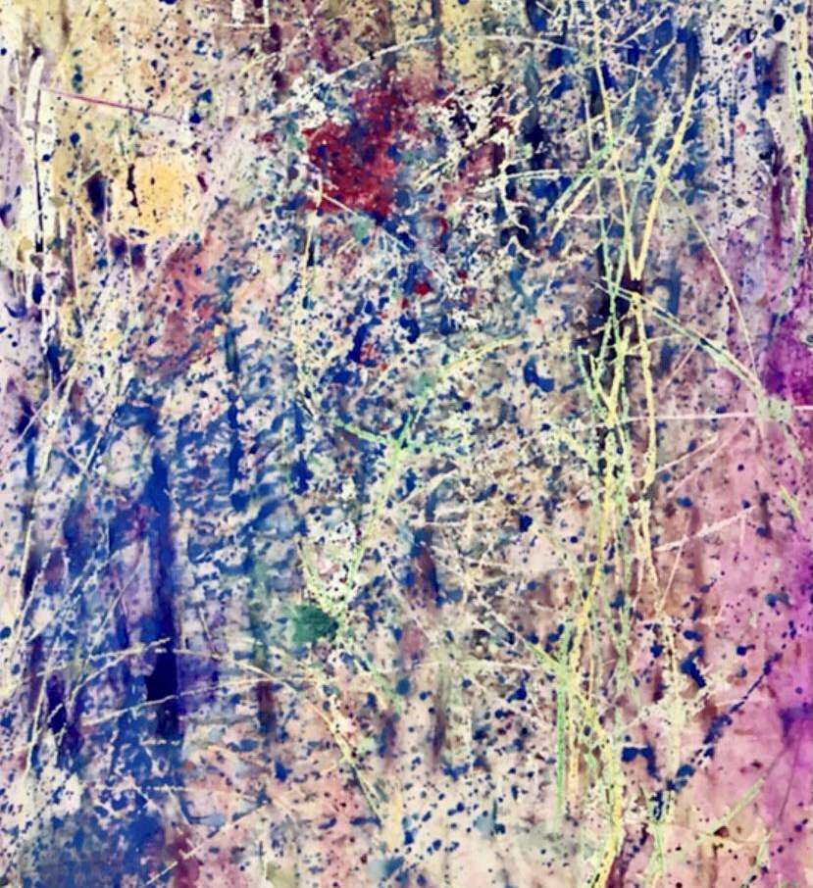
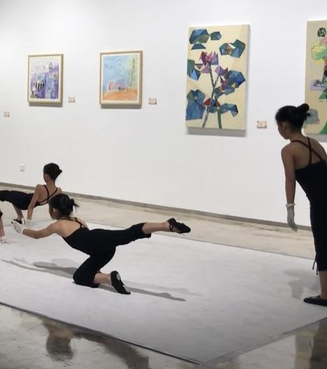
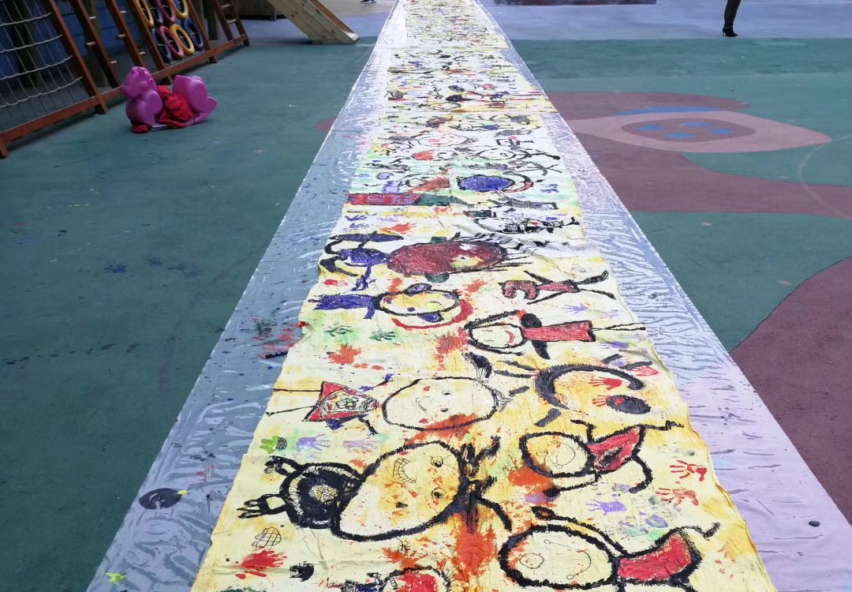
Community Art Program
2016-2021
Action Painting
Movement painting
Performance
I designed and guided various types of artistic expression for different populations in the community, including children, factory workers, and seniors.

Slide 12
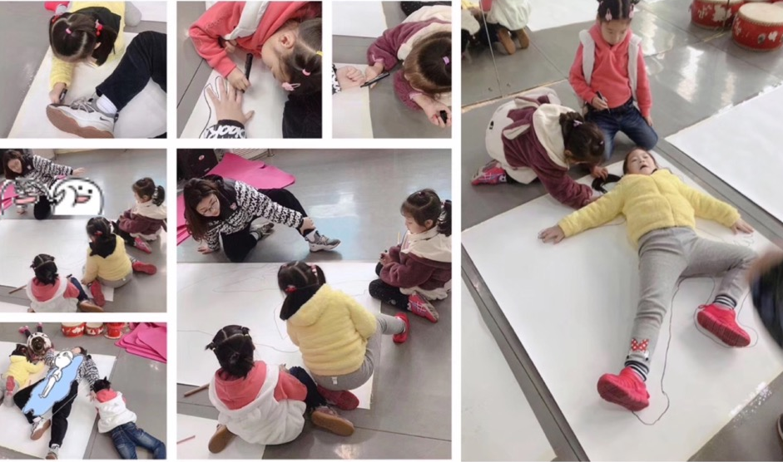
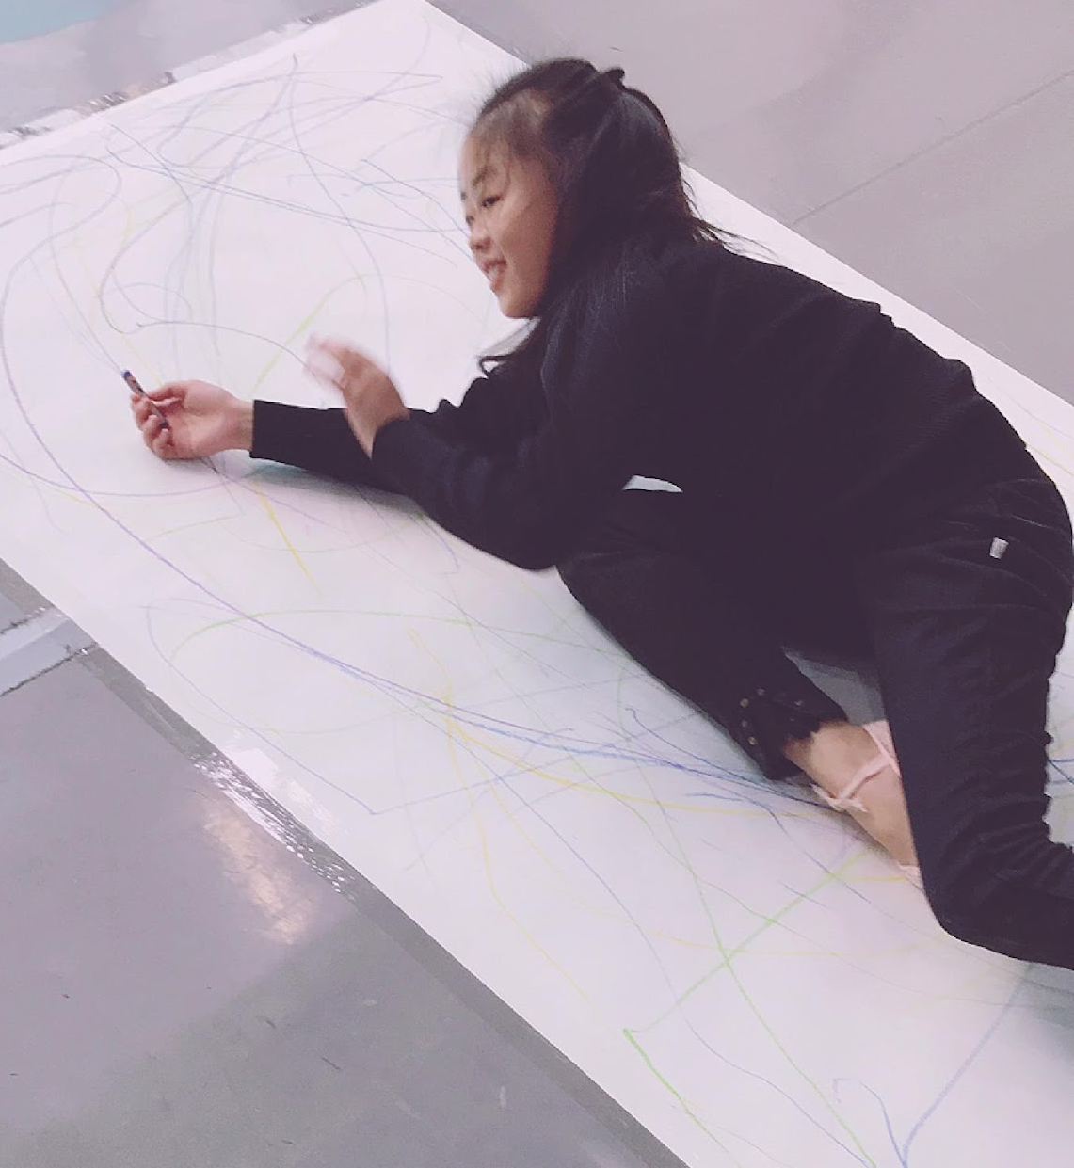
Movement Painting

Slide 13
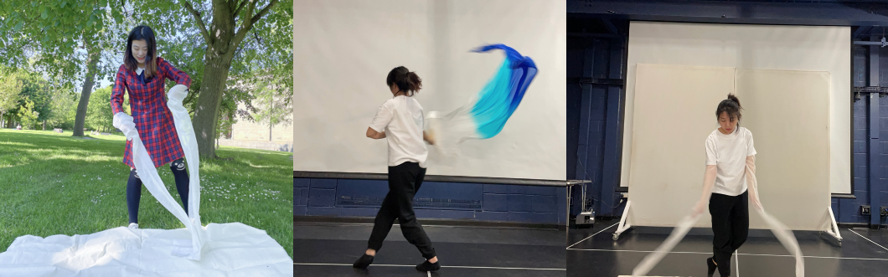
Performative Art
This project integrated different forms of art, such as Chinese traditional music, dance, and calligraphy.
The project utilized body as medium to deliver the concept that are proposed by Chinese traditional art: ‘Qi’. Qi represents rhythm and strength of movement, which further guides visual art creation.

Slide 14


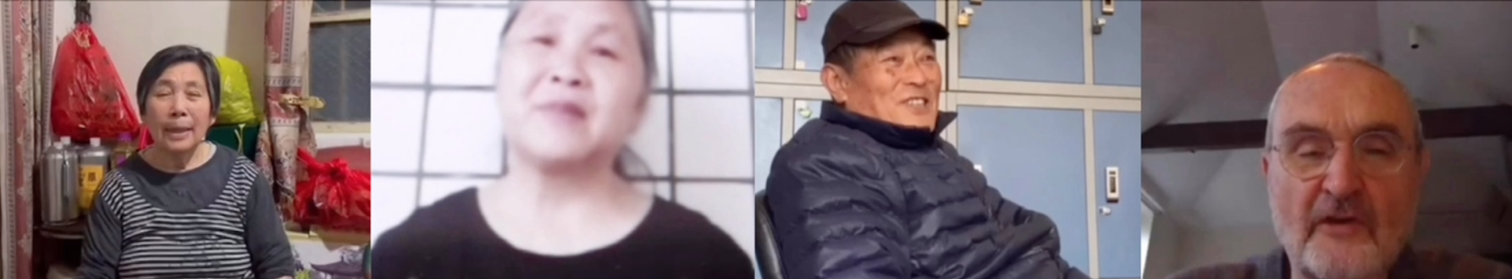
Inter-generational Documentary Project
This documentary gathers life stories from seniors from different countries. It includes two parts, reflection on their life and suggestions for young people.
This documentary project is a teamwork. I collaborated with other students in the University of Leeds. My responsibilities included conducting interviews and film editing.
video link: https://www.youtube.com/watch?v=id-UrcJlaK4

Slide 15
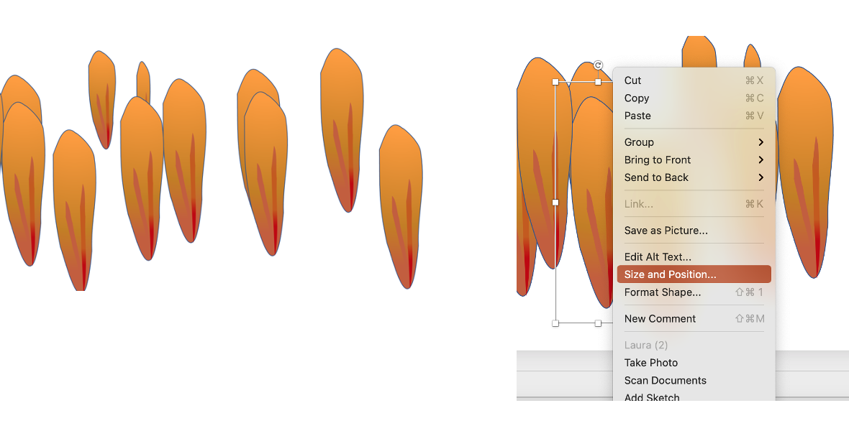
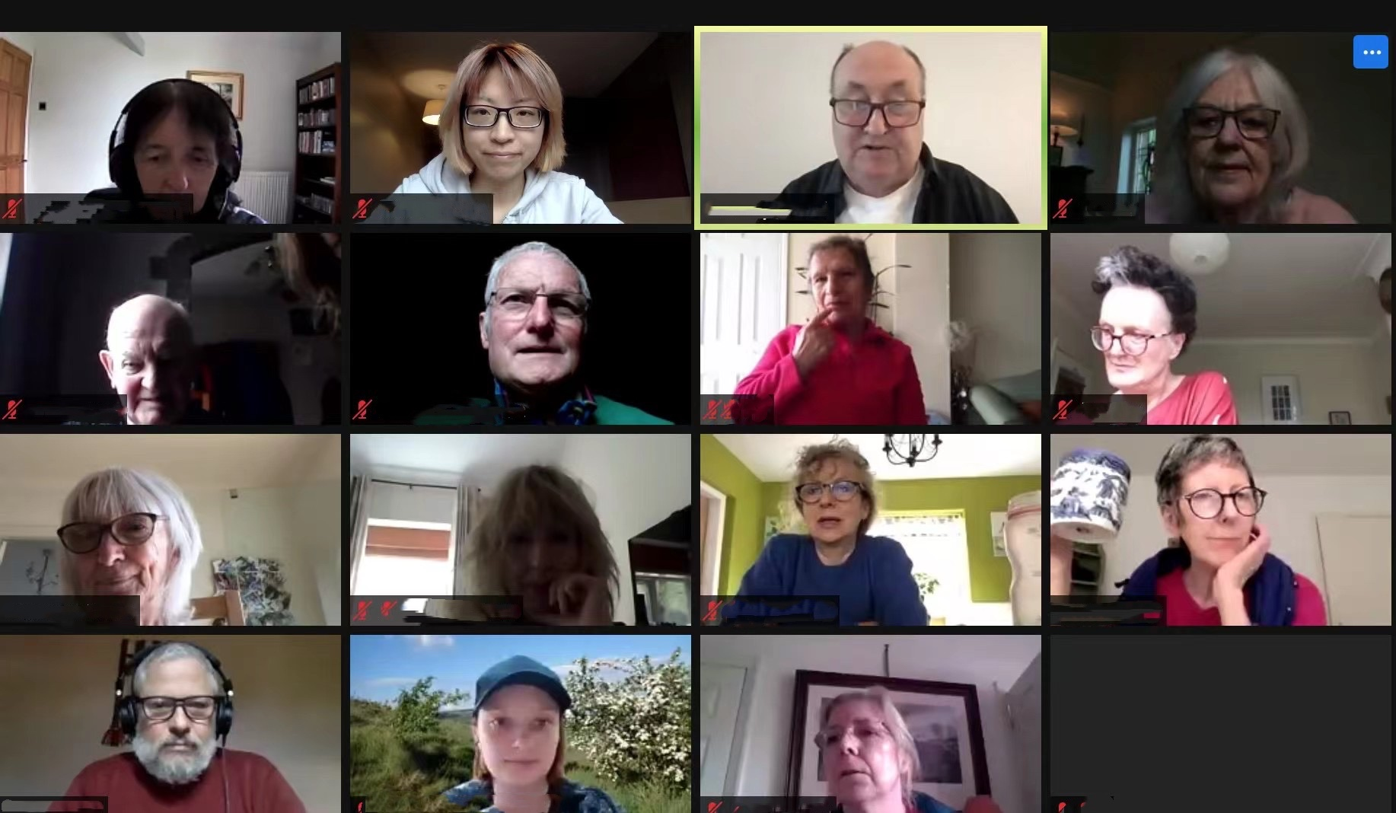

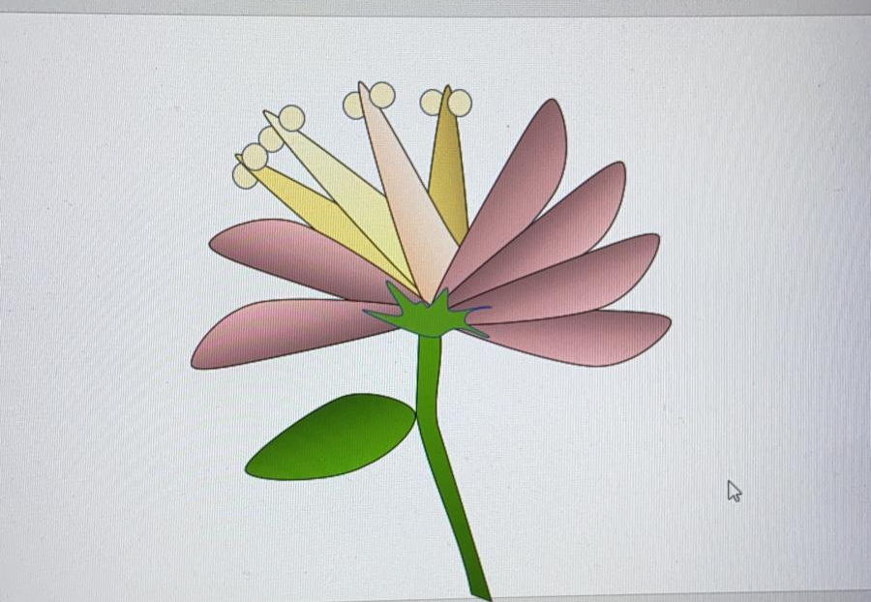

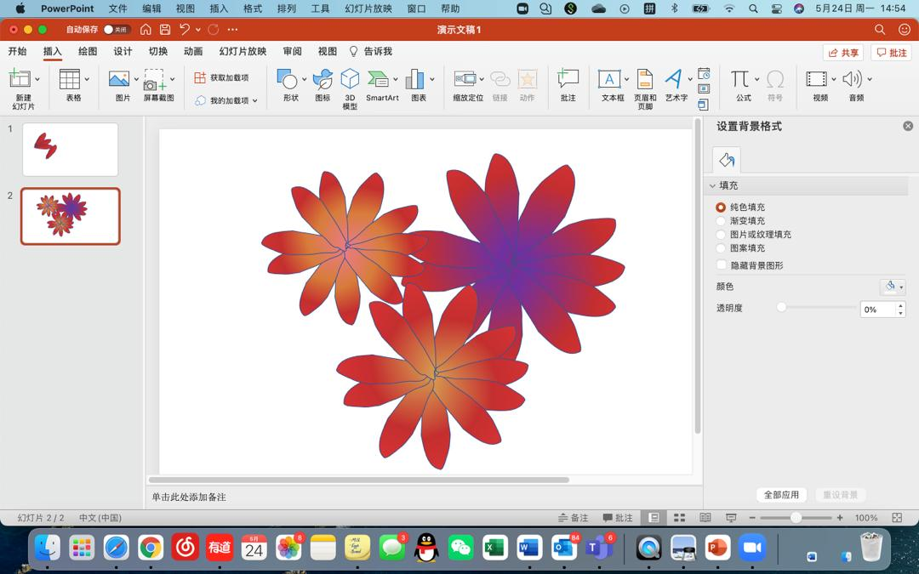
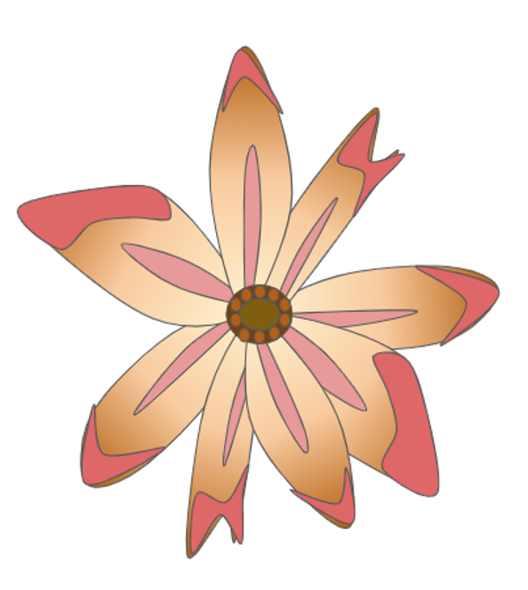
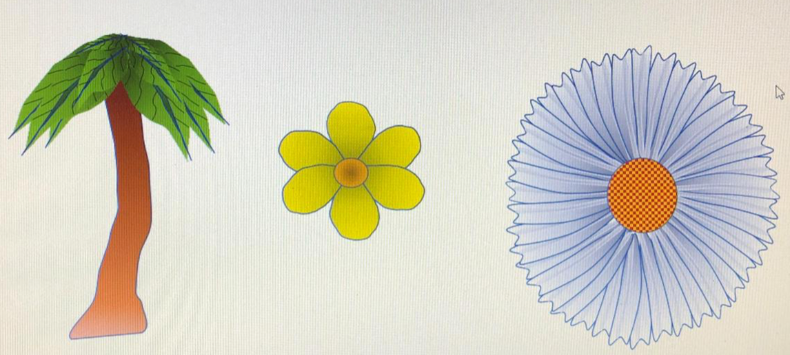

Inter-generational Art-Teaching Project
In this project, I taught seniors how to draw flowers and trees using PowerPoint via Zoom. These are their work

Slide 16
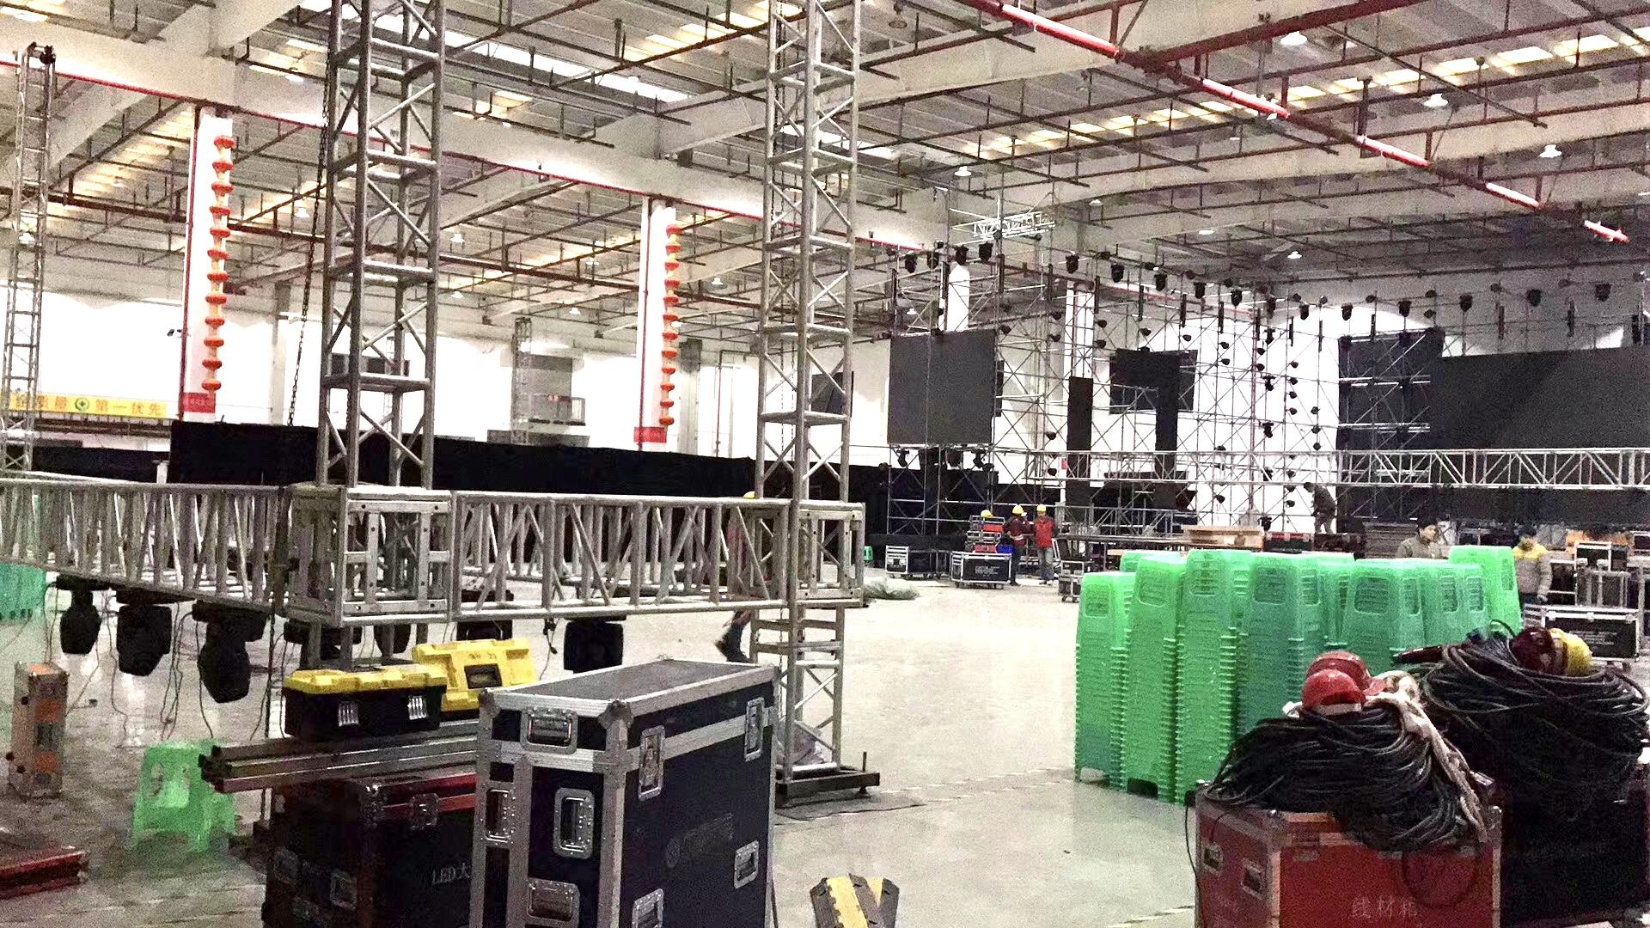
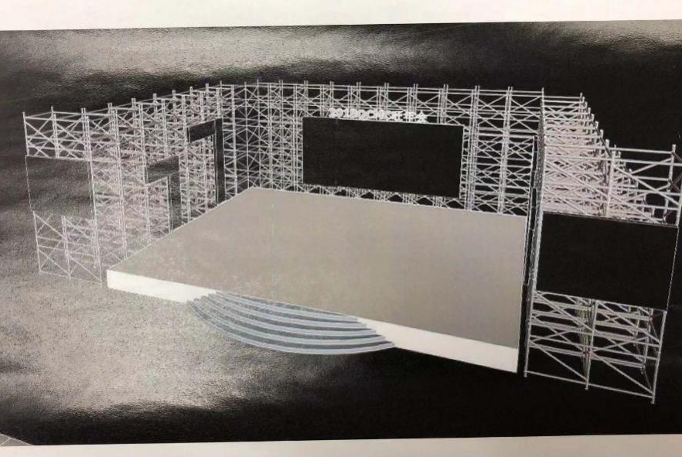
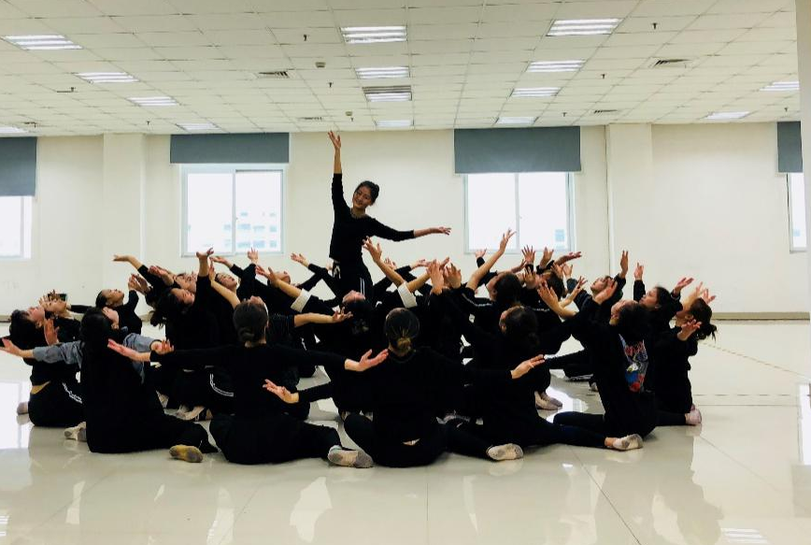
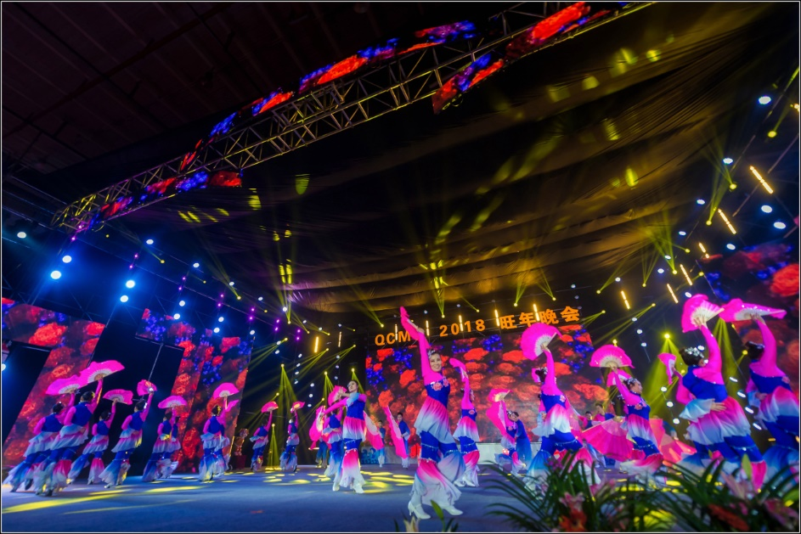
QSMC 2018 Evening Party
In electronics factories in China, the suicide rate is very high. In order to brighten the spirits of factory workers, I designed and directed a program for their benefit. My responsibilities included orchestrating the stage design, making props, creating costumes, and directing various types of visual artists in the performances.
Stage Design
Performance Direction

